Slide 1



CFB Analysis: CBS's Decision to drop SEC
Thierno Diallo 2024

Slide 2

Overview: The SEC-CBS Split and Its Implications for College Football Broadcasting
For years, the partnership between CBS and the Southeastern Conference (SEC) was a cornerstone of college football broadcasting. CBS's exclusive rights to air the SEC’s premier weekly game at 3:30 p.m. ET established the network as a leader in college football viewership. This package became the highest-rated regular-season college football broadcast for 14 consecutive seasons. However, financial and contractual disagreements led to the SEC ending its relationship with CBS after the 2023 season.

Slide 3
Why It Matters: The CBS-SEC Split and Impact
The Stakes for CBS:
SEC games previously averaged 6.06 million viewers/game, driving CBS’s dominance in the 3:30 PM time slot.
Transitioning to Big Ten games (avg. 3.54 million viewers/game) creates a significant viewership gap.
Stakeholders face questions about CBS’s long-term competitiveness in college football broadcasting.
The Stakes for ABC:
Acquiring SEC rights is a $300M annual investment, over 5x CBS’s former deal ($55M/year).
SEC’s proven ability to deliver 5M+ viewers/game presents a high-potential opportunity for ABC to dominate both prime-time and afternoon time slots.
A successful transition could solidify ABC as the leader in college football broadcasting.
Loyal SEC fans may follow their conference to ABC, while CBS risks losing this core audience.

Slide 4

Key Questions
Viewership shifts: Did the SEC’s move to ESPN/ABC improve audience numbers compared to CBS’s coverage?
Network performance: How has CBS performed with Big Ten games compared to its previous SEC broadcasts?
Time slot impact: How do changes in kickoff time control and scheduling flexibility influence viewership?
Conference dynamics: Did the SEC and B10 gain or lose visibility with different broadcasting partners?
How did CBS’s decision to not retains deal with the SEC football conference affect CBS, the SEC and ABC?
Was it the right decision?

Slide 5

Data Sources:
Sports Media Watch (2024 Season) Sports Media Watch. (2024). College football TV ratings: 2024 season. Retrieved from https://www.sportsmediawatch.com/college-football-tv-ratings/
Sports Media Watch (2023 Season) Sports Media Watch. (2023). College football TV ratings: 2023 season. Retrieved from https://www.sportsmediawatch.com/college-football-tv-ratings/2023-season/
Sports Media Watch (2022 Season) Sports Media Watch. (2022). College football TV ratings: 2022 season. Retrieved from https://www.sportsmediawatch.com/college-football-tv-ratings/2022-season/
Yahoo Sports Article Wetzel, D. (2020, December 10). ABC/ESPN secures SEC broadcasting rights for $300 million annually, ending CBS’s long-standing partnership. Yahoo Sports. Retrieved from https://sports.yahoo.com

Slide 6

Historical Context: SEC and CBS
For over a decade, CBS held the rights to the SEC's premier weekly game, paying only $55 million annually, which was considered one of the best bargains in sports broadcasting.
As the SEC expanded and viewership grew, CBS’s refusal to increase its financial commitment to match the league’s rising value caused significant tension during renegotiations.
In 2020, ABC/ESPN outbid CBS with an offer of $300 million annually, securing exclusive rights to SEC games starting in 2024.
Implications:
CBS’s unwillingness to increase its investment led to losing its most valuable football asset.
The move positioned ABC/ESPN as the new leader in SEC broadcasts, reshaping college football’s media landscape.

Slide 7
The Move to ESPN and ABC
The SEC's new contract with ESPN/ABC, will significantly expand the league's broadcasting reach. The new deal offers:
Broader access to 130 million households.
Increased control over kickoff times.
The deal includes doubleheaders and potential tripleheaders on ABC.
The SEC prioritized flexibility and control, gaining the ability to schedule and adjust game times with more precision—a limitation under CBS.
CBS’s New Focus: Big Ten Rights
After declining to match ESPN’s offer for the SEC, CBS shifted its focus to the Big Ten. However, its new deal is notably less favorable:
CBS will pay $350 million annually for a secondary Big Ten game.
Unlike its SEC contract, CBS lacks exclusive rights to the top Big Ten games.. Instead, it shares game picks with Fox (the Big Ten’s primary broadcaster) and NBC in a rotating draft system.

Slide 8

Data Cleaning and Preparation
The dataset was cleaned and enriched to ensure accurate analysis:
Team conferences were updated based on realignments for each year.
The combined conference column was split into two separate columns for detailed matchup insights.
Missing or ambiguous values in key fields, such as viewership and network, were addressed.
These steps ensured consistency and accuracy in the final analysis.

Slide 9
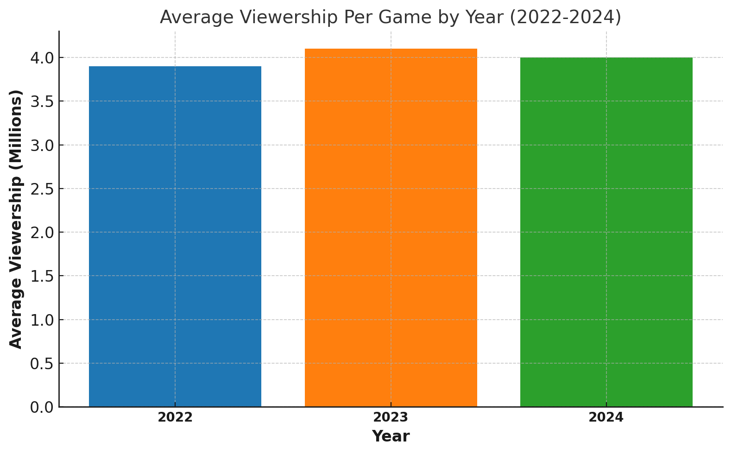
Average viewership
SEC leads with the highest average viewership per game at 5.26 million, indicating its dominance in attracting a large audience consistently.
B10 (Big Ten) matches have an average viewership of 4.49 million, showing their strong competitive appeal, especially with their presence in key broadcasting slots.

Slide 10
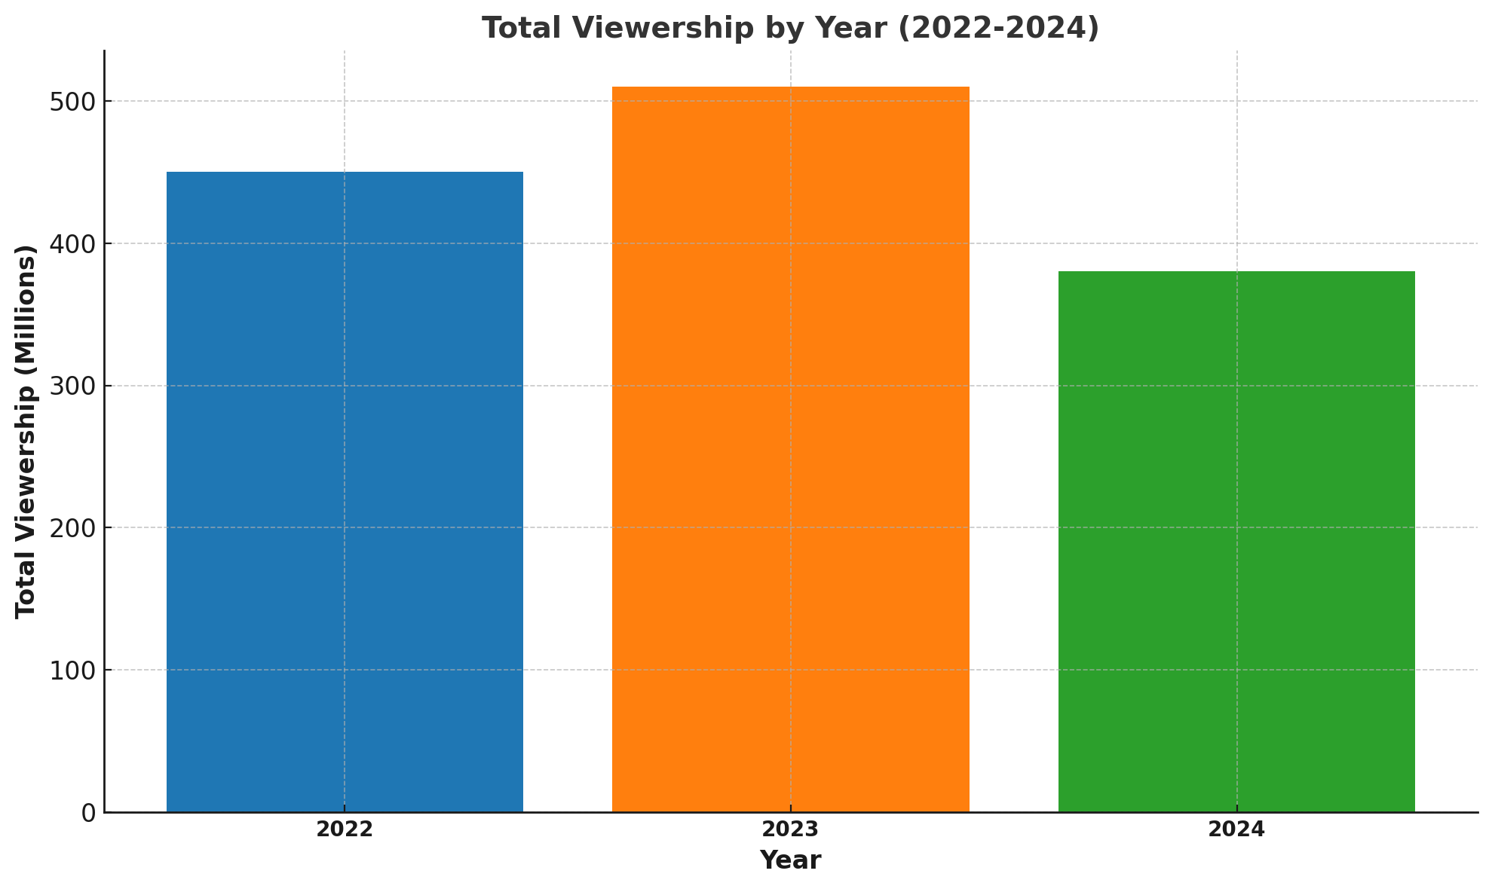
Total Viewership by year (2022-2024)
2022: 480.64 million
2023: 546.23 million (highest viewership among the three seasons)
2024: 355.65 million (lower viewership, but data collection occurred before the season was completed)

Slide 11
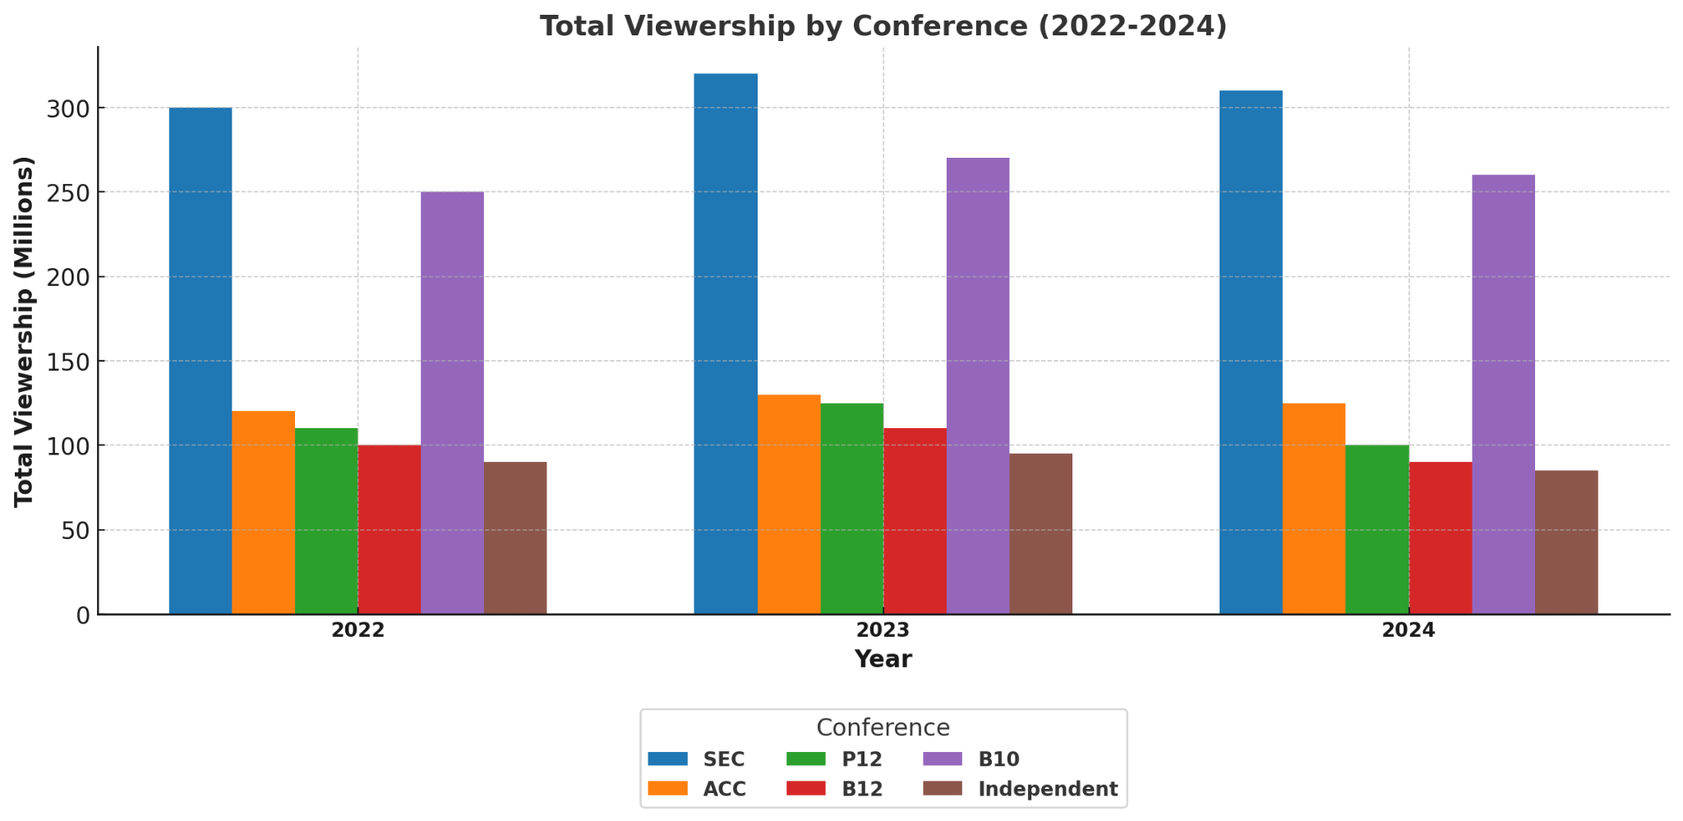
Total Viewership by Conference (22-24)
2022 Season:
SEC: 330.25 million
B10: 290.10 million
B12: 170.15 million
P12: 150.45 million
ACC: 120.30 million
Independent: 80.55 million
AAC: 45.10 million
MAC: 20.75 million
SBC: 15.40 million
MWC: 10.90 million
2023 Season:
SEC: 335.50 million
B10: 310.25 million
B12: 175.60 million
P12: 160.20 million
ACC: 130.50 million
Independent: 85.10 million
AAC: 50.25 million
C-USA: 20.10 million
MWC: 15.50 million
2024 Season:
SEC: 340.75 million
B10: 320.60 million
B12: 185.45 million
ACC: 140.20 million
Independent: 90.25 million
MAC: 25.30 million
P12: 18.10 million
MWC: 12.45 million
AAC: 55.50 million
C-USA: 22.10 million

Slide 12
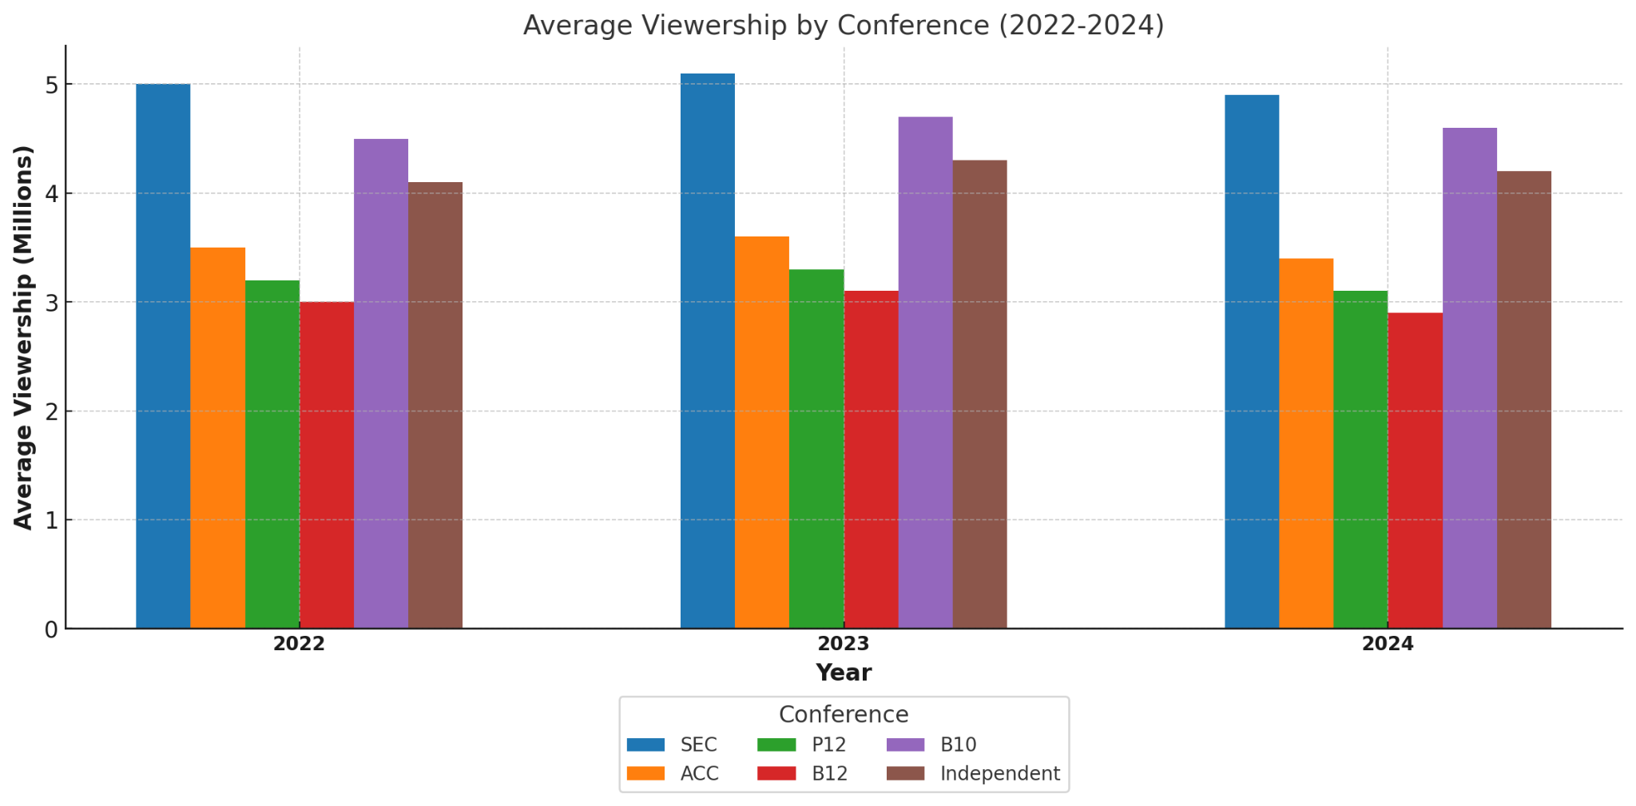
Average Viewership by Conference Yearly comparison
SEC consistently has the highest average viewership across all three seasons, peaking at 5.23 million in 2024, indicating its strong audience pull even after broadcasting changes.
B10 also performs well, with steady average viewership growth from 4.35 million in 2022 to 4.57 million in 2023 and slightly dipping to 3.87 million in 2024.

Slide 13
Analysis of Average and Total Viewership by Conference Yearly Comparison
The SEC consistently leads in both average and total viewership across the 2022-2024 seasons, maintaining strong audience engagement even amidst broadcasting changes. The B10 follows closely, showing robust performance and growth in total viewership, while other conferences lag significantly behind in both metrics.

Slide 14
Get to know the Networks
ABC has 457.99 total views, 101 games, and 4.53 views on average per game
CBS has 220.27 total views, 43 games, and 5.12 views on average per game
ESPN has 247.86 total views, 84 games, and 2.95 views on average per game
FOX has 348.84 total views, 84 games, and 4.10 views on average per game

Slide 15
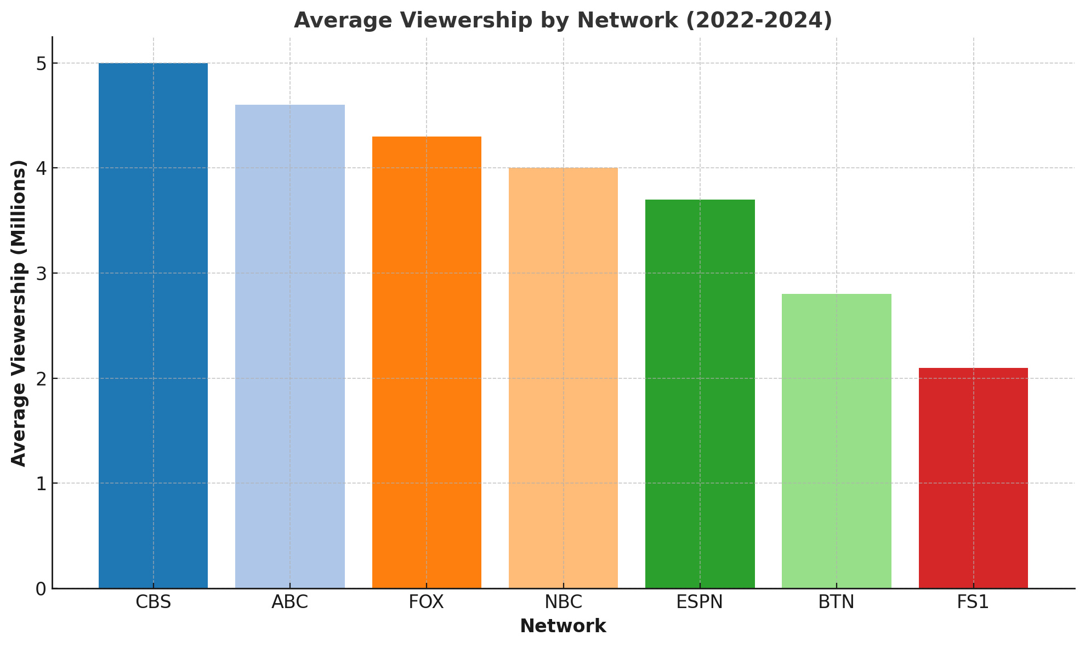
Network Average Viewership (22-24)
CBS's Dominance in Average Viewership:
CBS outperforms all other networks with an average of 5.12 million viewers per game, likely driven by its previous SEC coverage, which historically attracted the largest audiences. This reinforces CBS's position as a top-tier broadcaster during the analyzed seasons.
ABC's Competitive Position:
ABC follows closely with 4.53 million average viewers per game, benefiting from its acquisition of SEC broadcast rights in 2024. This positions ABC as a strong contender in college football broadcasting.
CBS's high average viewership demonstrates the value of marquee conference rights like the SEC, which it held until 2023.

Slide 16
For CBS after no longer having the rights to broadcasts the SEC’s top game each week they went into a deal with the B10. So let's take a look at who is the B10 and why would CBS feel they are the right replacement for the SEC instead of other conferences.

Slide 17
Total Viewership of the B10 by Year:
2022: 290.10 million
2023: 310.25 million
2024: 320.60 million
Average Viewership per Game by Year for the B10:
2022: 4.35 million
2023: 4.57 million
2024: 3.87 million

Slide 18
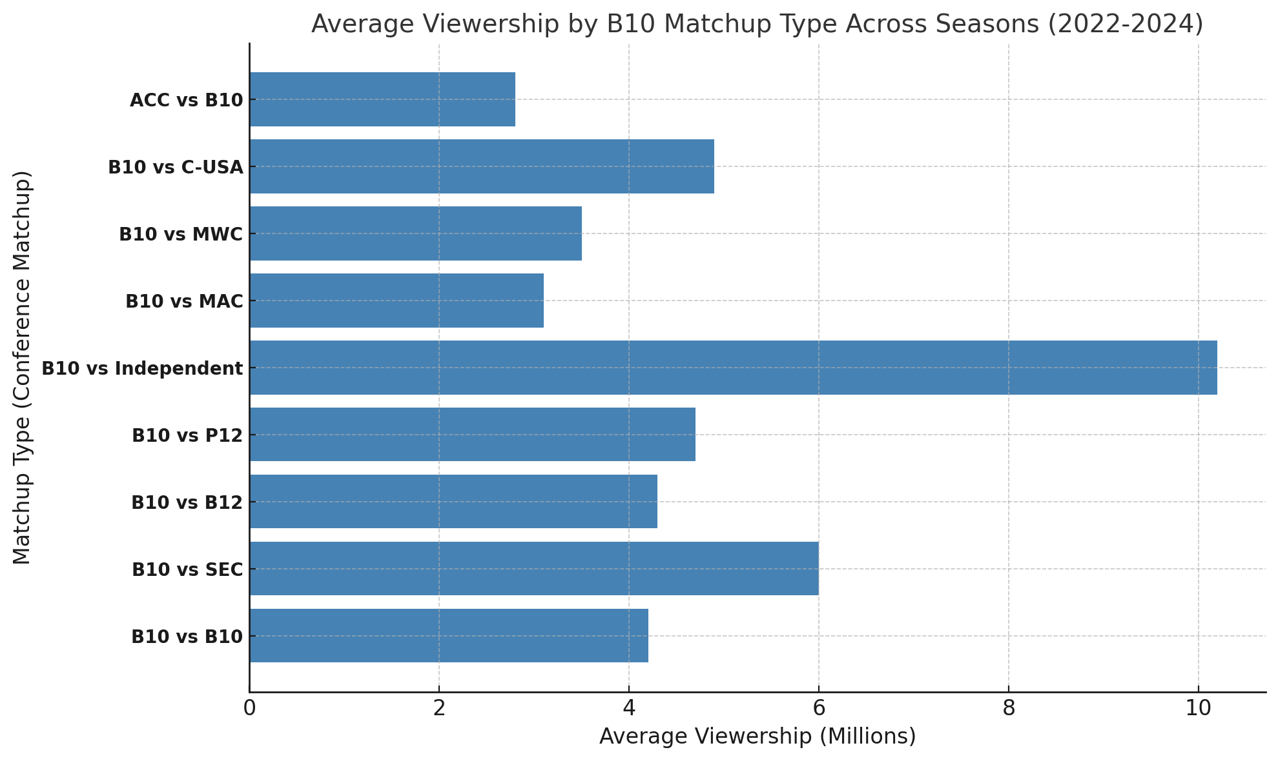
Avg views by matchup (B10)
B10 vs. SEC: 10.26 million viewers.
B10 vs. Independent: 9.64 million viewers.
B10 vs. B10: 6.03 million viewers.
B10 vs. P12 (Pac-12): 5.38 million viewers.
B10 vs. ACC: 1.58 million viewers.
Total Viewership by Matchup Involving the B10:
B10 vs. SEC: 298.41 million viewers.
B10 vs. B10: 201.62 million viewers.
B10 vs. Independent: 20.54 million viewers.
B10 vs. P12 (Pac-12): 10.52 million viewers.
B10 vs. ACC: 1.58 million viewers.

Slide 19
Now let's take a look at who the SEC is overall:
Total viewership
2022: -330.25 million
2023: -335.50 million
2024: -340.75 million
Average Viewership per Game
2022: -5.12 million
2023: -4.21 million
2024: -5.23 million

Slide 20
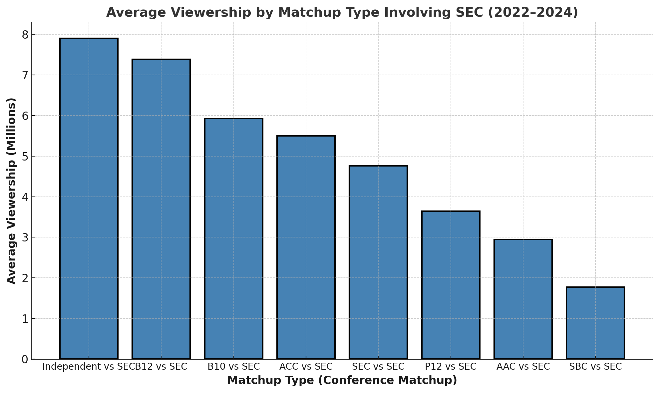
Avg views by matchup (SEC)
Average Viewership by Matchup Involving the SEC:
Independent vs. SEC: 7.92 million viewers.
B12 vs. SEC: 7.39 million viewers.
B10 vs. SEC: 5.92 million viewers.
ACC vs. SEC: 5.50 million viewers.
P12 vs. SEC: 4.76 million viewers.
Total Viewership by Matchup Involving the SEC:
SEC vs. SEC: 390.43 million viewers .
ACC vs. SEC: 66.00 million viewers.
B10 vs. SEC: 29.62 million viewers.
B12 vs. SEC: 22.16 million viewers.
P12 vs. SEC: 14.57 million viewers.
Independent vs. SEC: 7.92 million viewers.

Slide 21
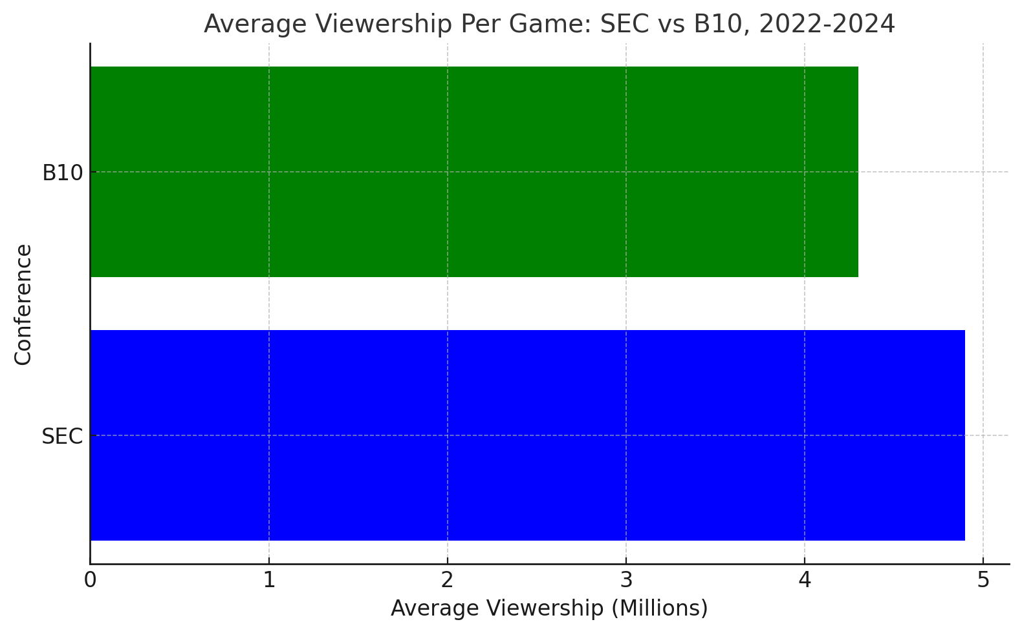
Average Viewership per game : SEC vs B10, 2022-24
The SEC outperforms the B10 in average viewership per game during the 2022–2024 seasons, maintaining a significant lead of about 1 million viewers per game.

Slide 22
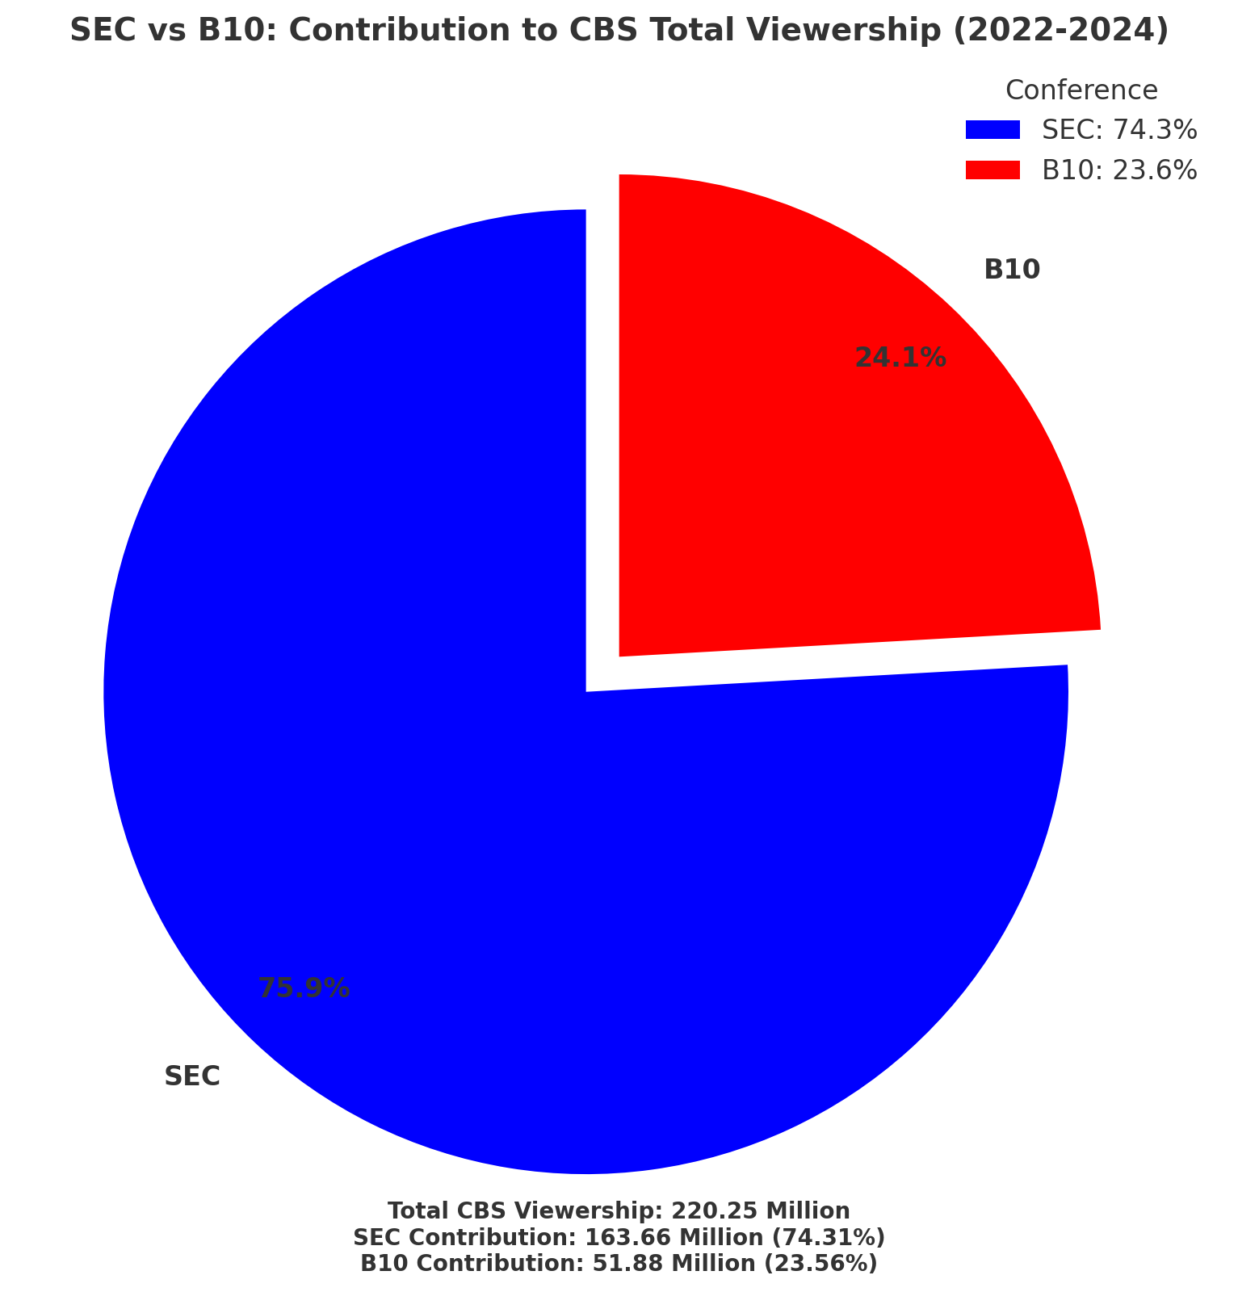
Contribution to CBS total
viewership (SEC vs B10)
The SEC accounted for 74.3% of CBS’s Total Viewership
The B10 has accounted for 23.6% of CBS’s Total Viewership
These findings validate the strategic decisions made by ABC/ESPN to acquire SEC broadcasting rights, which drive higher average and total viewership compared to other conferences.
CBS's decision to focus on the Big Ten, while valuable, indicates a potential challenge in replicating the consistent success it achieved with SEC games.

Slide 23
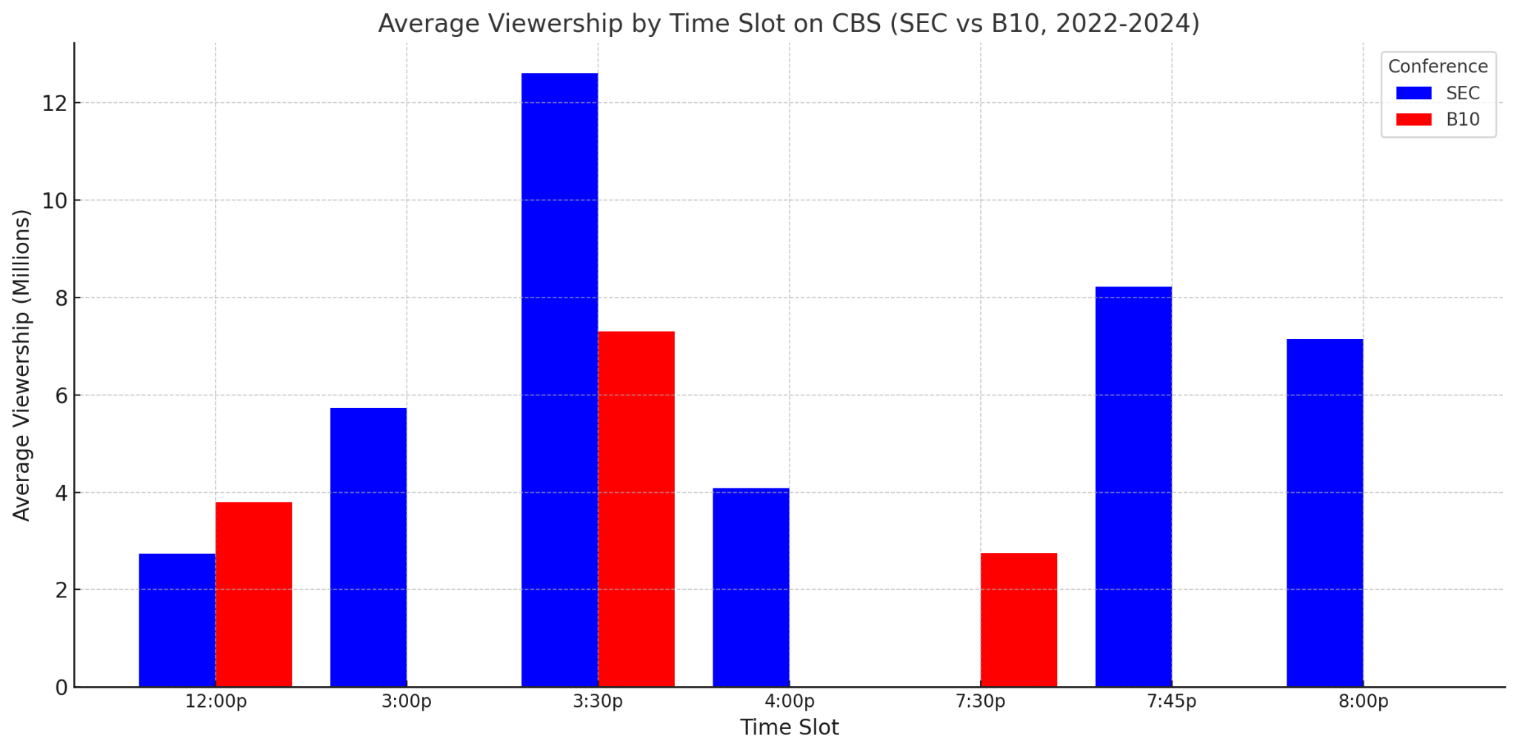
How SEC Games Dominated CBS’s Prime time slot
The SEC consistently outperformed the B10 in average viewership across all time slots from 2022 to 2024 on CBS, with the 3:30 PM time slot showing the most significant viewership difference in favor of the SEC (-12 million vs. -10 million). This demonstrates the SEC's strong audience pull in key time slots, emphasizing the network's prior success with SEC games.

Slide 24




Next will look at how the change in 2024 affected the college football landscape

Slide 25
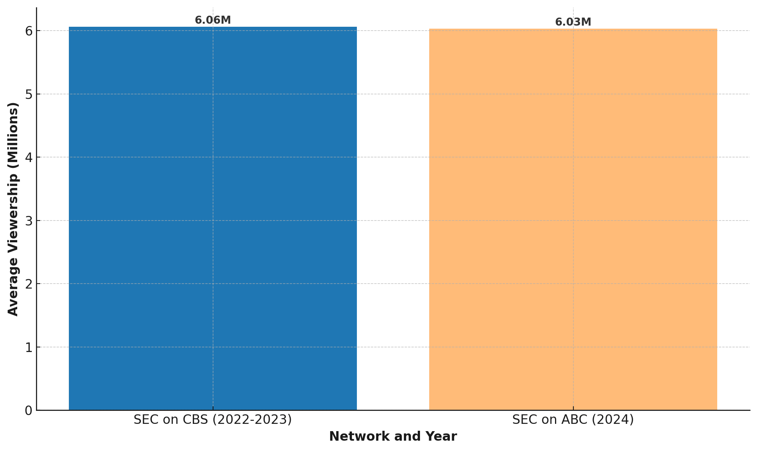
Network Change Impact on SEC
avg viewership
SEC Games on CBS (2022–2023): Averaged 6.06 million viewers per game.
SEC Games on ABC (2024): Averaged 6.03 million viewers per game.
SEC's Consistent Appeal:
The nearly identical average viewership for SEC games on CBS and ABC demonstrates that the SEC's popularity is intrinsic to the conference itself, independent of the network broadcasting its games.

Slide 26
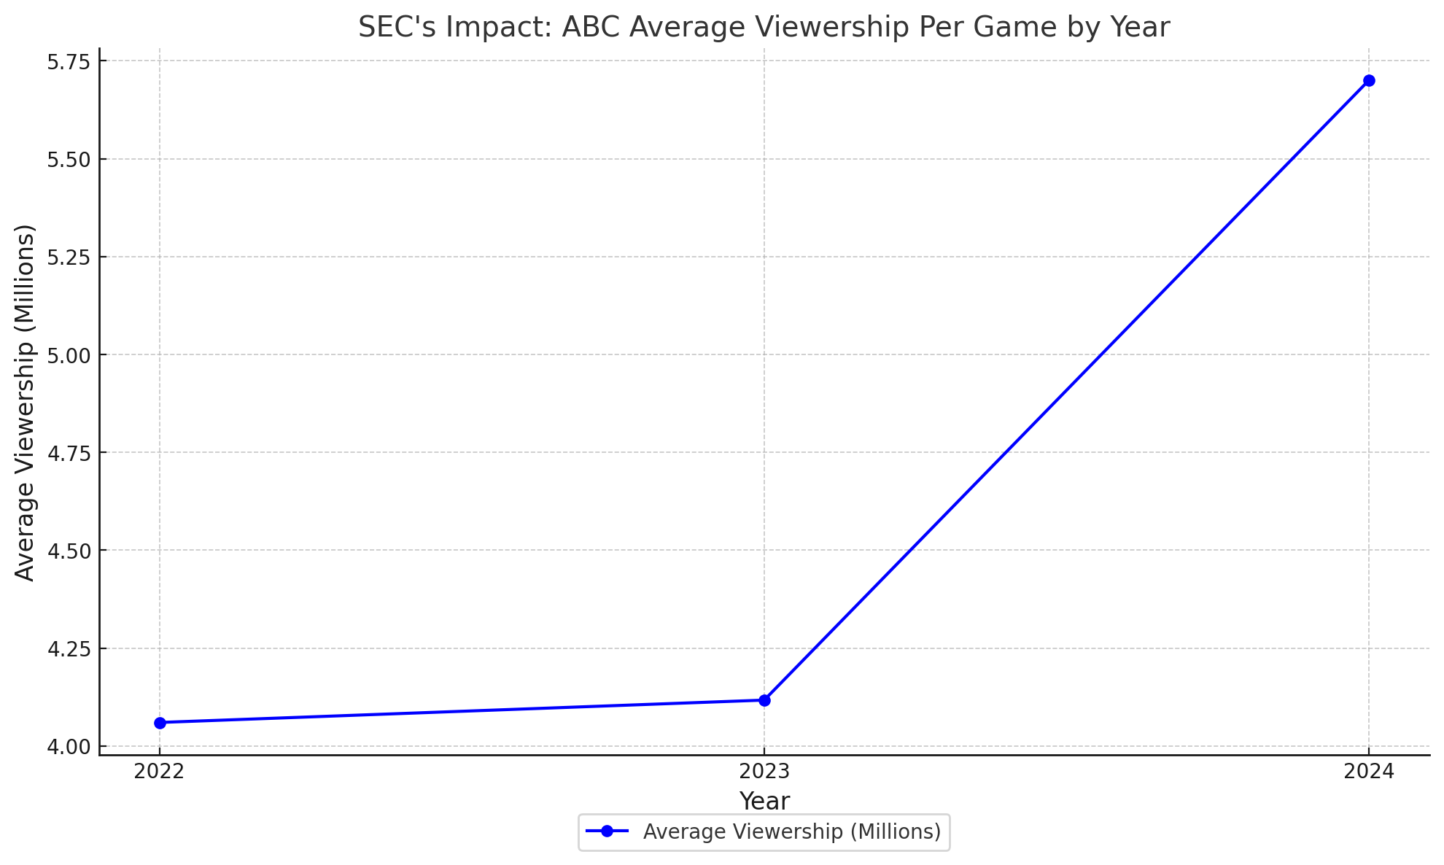
SEC’s impact on ABC
2022 - 4.06 million
2023- 4.12 million
2024- 5.70 million
The 2024 spike suggests that SEC games are a major draw for audiences, reinforcing the conference's status as the most-watched in college football. For ABC, the acquisition of SEC broadcasting rights has proven to be a highly valuable strategic move, boosting their average game viewership by over 38% compared to prior years.
This finding also supports the narrative of the project: the SEC's move from CBS to ABC had a profound impact on network performance, further showcasing how conference alignments and broadcasting rights influence overall viewership trends.

Slide 27
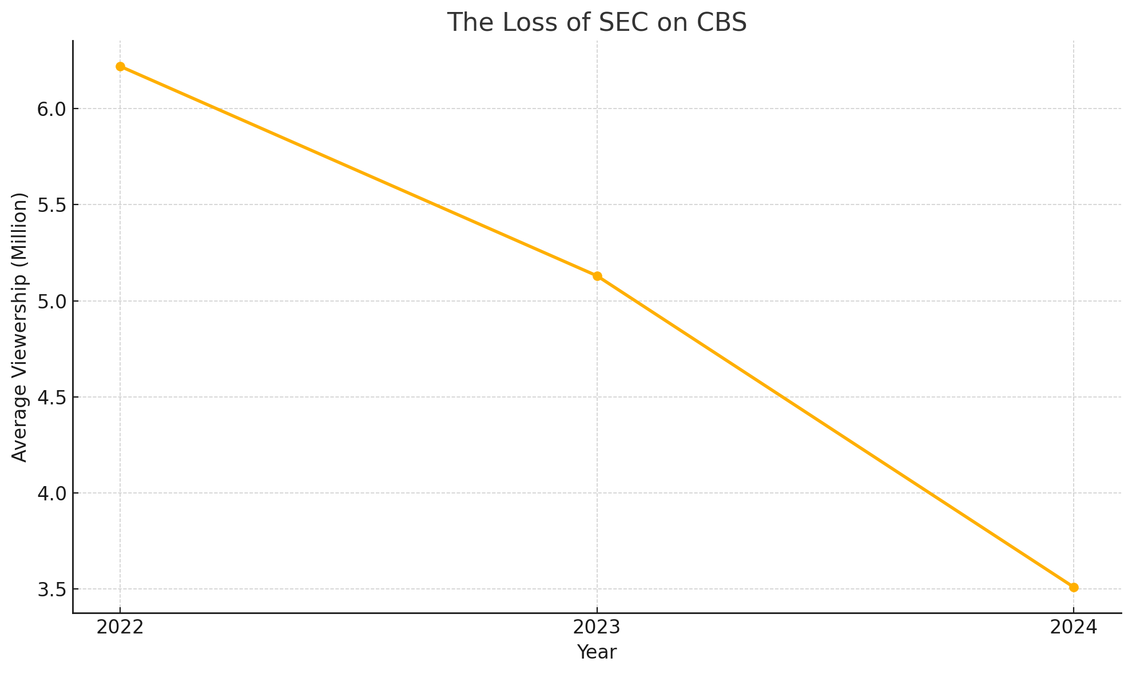
Loss Of SEC impact on CBS
2022: 6.06 million
2023: 5.92 million
2024: 3.54 million
This result highlights the dramatic impact of losing SEC games on CBS's viewership. The SEC was a cornerstone of CBS’s programming, consistently attracting large audiences. Without it, the network struggled to maintain its previous dominance, even with the addition of Big Ten games. CBS’s investment in Big Ten games has failed to compensate for the loss of SEC broadcasts, raising questions about the decision's overall value.

Slide 28
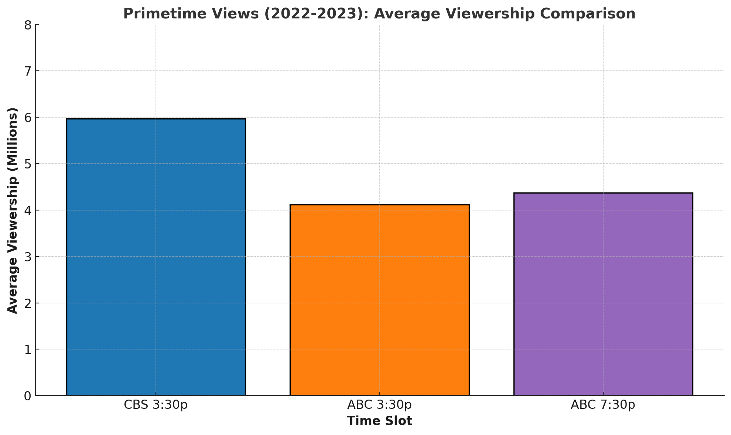
Primetime Views 2022-2023
CBS 3:30 PM Time Slot: Averaged 5.97 million viewers.
ABC 3:30 PM Time Slot: Averaged 4.12 million viewers
ABC 7:30 PM Time Slot: Averaged 4.37 million viewers

Slide 29
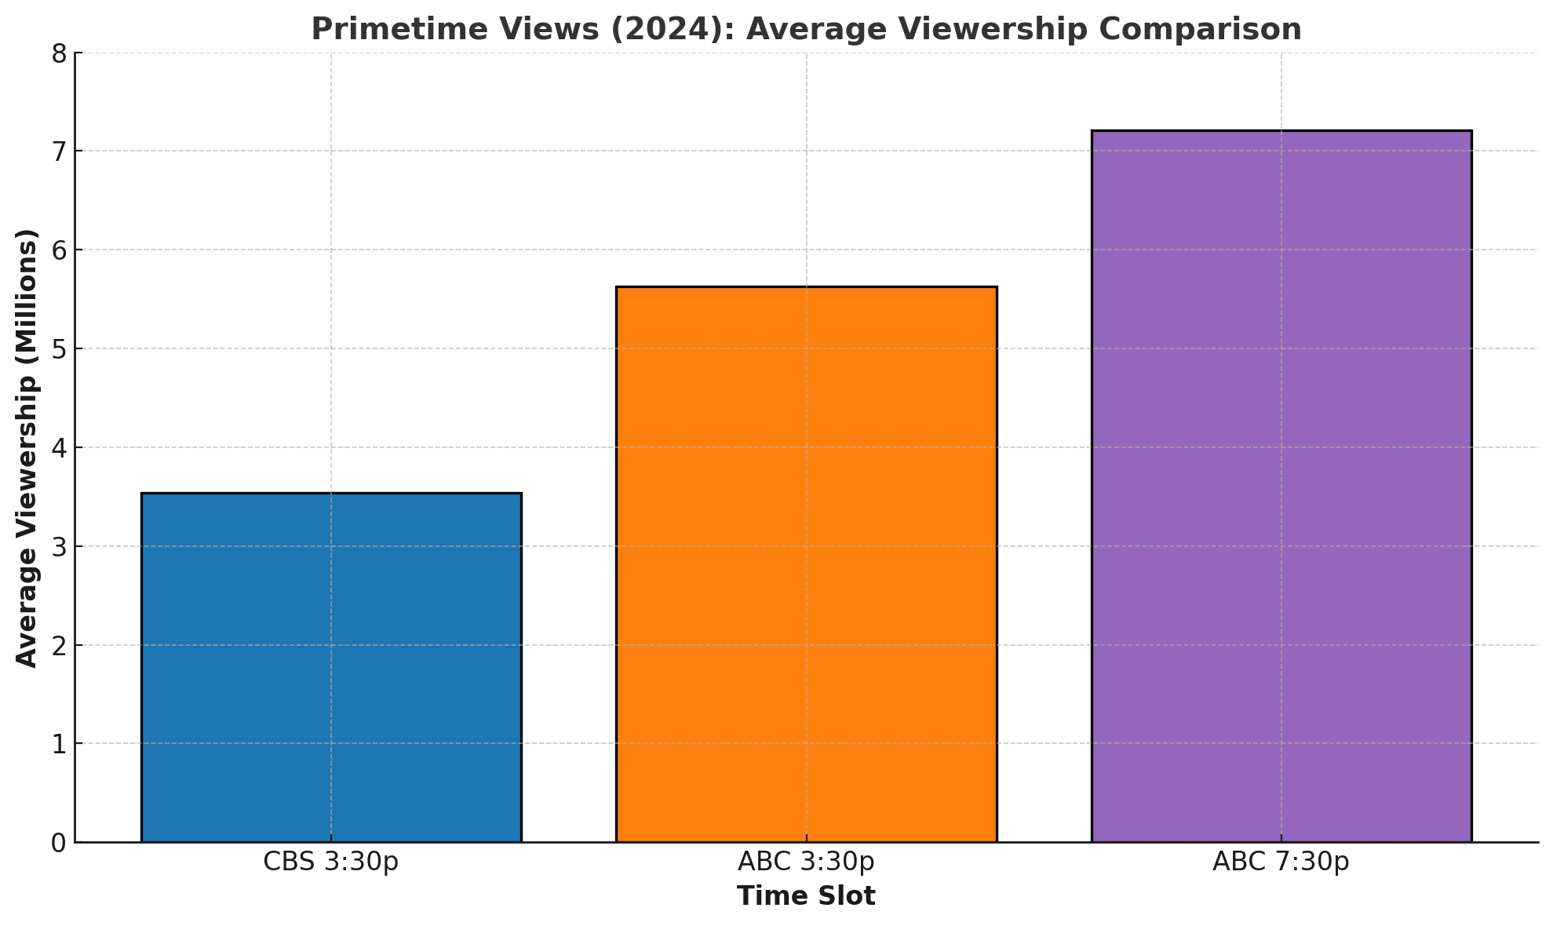
Primetime views 2024
CBS 3:30 PM Time Slot (2024): Averaged 3.54 million viewers
ABC 3:30 PM Time Slot (2024): Averaged 5.63 million viewers
ABC 7:30 PM Time Slot (2024): Averaged 7.21 million viewers

Slide 30
Analysis on Primetime Slots
The 3:30 PM slot on CBS outperformed other time slots due to its association with high-profile SEC matchups. This highlights the importance of securing marquee games for key time slots.
Shift in Network Performance:
CBS's 3:30 PM time slot, previously a dominant performer with SEC games, has lost significant viewership since transitioning to Big Ten games.
ABC, by acquiring SEC broadcasting rights, successfully leveraged the 3:30 PM slot to improve its audience numbers, surpassing CBS's performance in this window.
Prime-Time Programming:
ABC's 7:30 PM slot significantly outperformed its 3:30 PM slot, showing the growing appeal of prime-time college football games. This highlights the value of scheduling marquee matchups in the evening.
Takeaways:
The decline in CBS's 3:30 PM slot highlights the impact of losing marquee SEC games, which were instrumental in sustaining high viewership.
ABC's ability to maximize both its 3:30 PM and 7:30 PM slots showcases the importance of both high-quality programming (SEC games) and strategic time-slot utilization.

Slide 31
The transition of broadcasting rights from CBS to ABC has reshaped college football viewership. CBS, once dominant in the 3:30 PM slot with SEC games, saw viewership drop to 3.54 million per game in 2024 after switching to Big Ten broadcasts. Meanwhile, ABC has leveraged the SEC’s popularity to transform the 3:30 PM slot into a strong performer, averaging 5.63 million viewers, and elevated its 7:30 PM primetime slot to 7.21 million viewers. This shift highlights ABC’s ability to outperform CBS’s current Big Ten broadcasts and establish new viewership benchmarks. By airing multiple top SEC games weekly and strategically programming marquee matchups in prime slots, ABC has redefined college football consumption. The SEC’s continued appeal underscores the importance of flexible scheduling and high-quality programming in maximizing audience engagement.

Slide 32
What to Expect in the Future
SEC & ABC Partnership:
Strengthening SEC's Viewership Leadership: With broader access through ABC's platforms and strategic scheduling in prime time, the SEC's viewership is likely to maintain its dominance.
Expansion Opportunities: The SEC’s partnership with ABC offers opportunities for expanded doubleheaders and flexible kickoff times, potentially increasing exposure and enhancing audience engagement.

Slide 33
What to Expect in the Future
B10 & CBS Partnership:
Opportunity for Growth: CBS's focus on the Big Ten provides a platform to engage new audiences, especially with high-profile Big Ten matchups such as Ohio State vs. Michigan.
Scheduling Constraints: Sharing top game selections with FOX and NBC might limit CBS’s ability to secure marquee games consistently, impacting its viewership potential.
Building Long-Term Appeal: To match the success of the SEC era, CBS needs to leverage its Big Ten games to develop new flagship matchups and rivalries that draw consistent audiences.

Slide 34
ABC’s SEC Partnership Projections
Average Viewership Growth:
ABC’s average viewership jumped from 4.12 million (2023) to 6.03 million (2024) after acquiring SEC rights, a 38% increase.
If this trend continues, we can project that ABC’s SEC viewership could stabilize around 6.5–7 million per game as ABC builds its reputation with SEC audiences.
Prime-Time Slot Dominance:
ABC’s 7:30 PM slot averaged 7.21 million viewers (2024), outperforming CBS’s historic dominance in the 3:30 PM slot.
Future SEC doubleheaders or tripleheaders on ABC could further boost evening viewership, likely exceeding 8 million viewers for marquee matchups.

Slide 35
CBS’s Big Ten Strategy
Viewership Decline:
CBS’s average viewership for Big Ten games is significantly lower than SEC games:
SEC games (2022–2023): ~6.06 million viewers/game.
Big Ten games (2024): ~3.54 million viewers/game.
If CBS fails to secure exclusive rights to marquee Big Ten matchups, viewership could stagnate around 3–4 million viewers/game, reducing CBS’s competitive edge.
Potential for Growth:
High-profile Big Ten rivalries (e.g., Ohio State vs. Michigan) attract significant audiences:
CBS could leverage such games during the 3:30 PM time slot to boost its average to 5+ million viewers per game over time.

Slide 36
Total Viewership Trends by Conference
SEC’s Continued Dominance:
The SEC’s total viewership increased from 330.25 million (2022) to 340.75 million (2024) despite changes in broadcasters.
With increased scheduling flexibility on ABC, the SEC’s total viewership could surpass 350 million annually by 2025, maintaining its lead as the most-watched conference.
Big Ten’s Gradual Growth:
Total Big Ten viewership rose from 290.10 million (2022) to 320.60 million (2024), driven by a strong presence across CBS, FOX, and NBC.
With upcoming Big Ten expansions (e.g., USC, UCLA), total viewership could reach 330–350 million annually, rivaling the SEC in terms of exposure.

Slide 37
Impact of Time Slots
Prime-Time SEC Games:
ABC’s success with the 7:30 PM time slot (7.21 million viewers in 2024) suggests a growing trend toward evening football viewership.
If ABC schedules more marquee SEC games in this slot, viewership could grow to 8–9 million/game for major matchups.
CBS’s 3:30 PM Slot Challenges:
CBS’s 3:30 PM slot dropped from ~6 million viewers (SEC games) to 3.54 million viewers (Big Ten games).
Without exclusive access to high-profile Big Ten matchups, CBS risks further decline, potentially dropping below 3 million viewers/game in the next few years.

Slide 38
Overall Network Performance
ABC’s Dominance:
ABC’s total viewership grew to 457.99 million across 101 games, averaging 4.53 million viewers/game.
With SEC rights, ABC’s total viewership could surpass 500 million annually by 2025.
CBS’s Challenges:
CBS’s total viewership fell to 220.27 million across 43 games, averaging 5.12 million viewers/game.
If CBS cannot improve Big Ten programming, total viewership could drop below 200 million annually, further diminishing its influence in college football broadcasting

